Slide 1

INSTITUTE :UIE
DEPARTMENT: ALL ACADEMIC UNITS
Bachelor of Engineering (All Sections)
Subject Name and Code:
Engineering Physics 23SPH-141
Prepared by: Ms. Arminder
UNIT 3
Introduction to Nanotechnology & Quantum Computing
DISCOVER . LEARN . EMPOWER

Slide 2
COURSE OBJECTIVES
The course is designed to make the students industry ready to contribute in the growing demand of the industry at local, national and international level.
It will make the students competent to understand basic concepts and applications of advanced engineering physics and apply its principles in their respective fields at global platform.
It will enhance the skill level of the students and shall make them preferred choice for getting employment in industry and research labs.
It will give thorough knowledge of the discipline to enable students to disseminate knowledge in pursuing excellence in academic areas.

Slide 3

COURSE OUTCOME
CO Number | Title On completion of this course, the students are expected to learn | Level
CO1 | Quote the basic fundamental concepts of lasers, optical fibres, crystallography, ultrasonic oscillations, semiconductor physics, quantum mechanics and nanotechnology. | Remember, Understand
CO2 | Demonstrate the working of various lasers, fibre components, semiconductor devices; explain the behaviour of crystalline solids, quantum and nano-scale systems. | Understand
CO3 | Solve problems by applying principles related to lasers, fibres, semiconductors, oscillations, quantum and nanoscience. | Applying
CO4 | Compare various lasers and fibres, semiconducting devices, crystalline materials, structures at quantum and nanoscale on the basis of their properties for industrial applications. | Analyze
CO5 | Develop various systems using lasers, fibres, semiconductors and nanomaterials for futuristic applications. | Design

Slide 4
LECTURE OBJECTIVE
Students will learn about quantum computing.
Students will understand how quantum computing developed.
Students will learn future prospect of quantum computing.

Slide 5
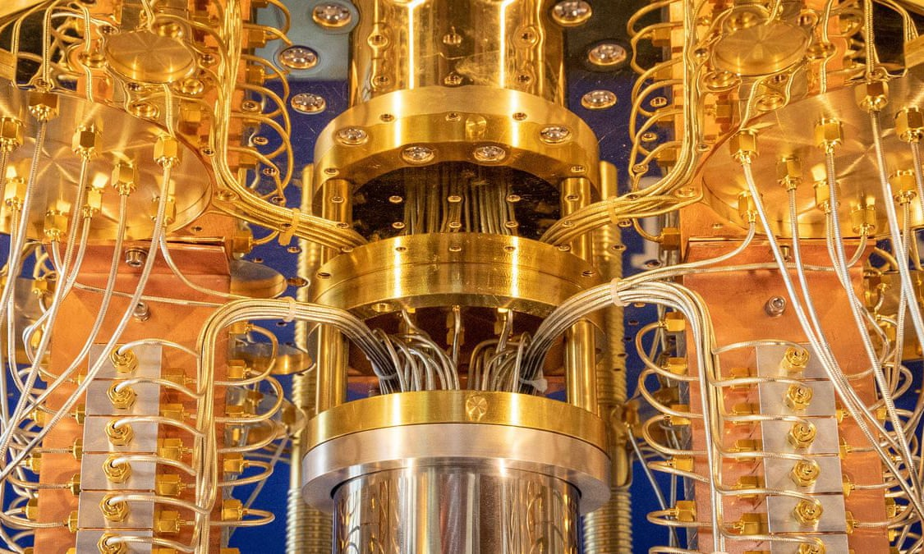
QUANTUM COMPUTING
Quantum computing is the use of quantum-mechanical phenomena such as superposition and entanglement to perform computation. Computers that perform quantum computations are known as quantum computers.
Figure 1: IBM’s new 53-qubit quantum computer [1]

Slide 6
QUANTUM COMPUTING
A quantum computer harnesses some of the almost-mystical phenomena of quantum mechanics to deliver huge leaps forward in processing power. Quantum machines promise to outstrip even the most capable of today’s—and tomorrow’s—supercomputers.
They won’t wipe out conventional computers, though. Using a classical machine will still be the easiest and most economical solution for tackling most problems. But quantum computers promise to power exciting advances in various fields, from materials science to pharmaceuticals research. Companies are already experimenting with them to develop things like lighter and more powerful batteries for electric cars, and to help create novel drugs.

Slide 7
QUANTUM COMPUTING
Quantum computers, on the other hand, use qubits, which are typically subatomic particles such as electrons or photons. Generating and managing qubits is a scientific and engineering challenge. Some companies, such as IBM, Google, and Rigetti Computing, use superconducting circuits cooled to temperatures colder than deep space.
Qubits have some quirky quantum properties that mean a connected group of them can provide way more processing power than the same number of binary bits. One of those properties is known as superposition and another is called entanglement.
All computing systems rely on a fundamental ability to store and manipulate information. Current computers manipulate individual bits, which store information as binary 0 and 1 states.

Slide 8
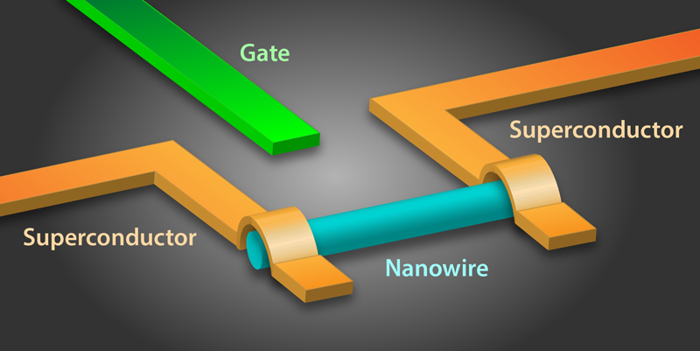
QUANTUM COMPUTING
Here, learn about the quantum properties leveraged by qubits, how they're used to compute, and how quantum systems scale.
There are a few different ways to create a qubit. One method uses superconductivity to create and maintain a quantum state. To work with these superconducting qubits for extended periods of time, they must be kept very cold. Any heat in the system can introduce error, which is why quantum computers operate at temperatures close to absolute zero, colder than the vacuum of space
Figure 2: wiring up superconducting qubits [2]

Slide 9
Quantum Vocabulary And Terminology
Following is a brief primer of quantum computing concepts and terms.
Qubits not bits. Quantum computers do calculations with quantum bits, or qubits, rather than the digital bits in traditional computers. Qubits allow quantum computers to consider previously unimaginable amounts of information.
Superposition. Quantum objects can be in more than one state at the same time, a situation depicted by Schrödinger’s cat, a fictional feline that is simultaneously alive and dead. For example, a qubit can represent the values 0 and 1 simultaneously, whereas classical bits can only be either a 0 or a 1.
Entanglement. When qubits are entangled, they form a connection to each other that survives no matter the distance between them. A change to one qubit will alter its entangled twin, a finding that baffled even Einstein, who called entanglement “spooky action at a distance.”

Slide 10
Quantum Vocabulary And Terminology
Types of qubits. At the core of the quantum computer is the qubit, a quantum bit of information typically made from a particle so small that it exhibits quantum properties rather than obeying the classical laws of physics that govern our everyday lives. A number of types of qubits are in development:
Superconducting qubits, or transmons. Already in use in prototype computers made by Google, IBM and others, these qubits are made from superconducting electrical circuits.
Trapped atoms. Atoms trapped in place by lasers can behave as qubits. Trapped ions (charged atoms) can also act as qubits.
Silicon spin qubits. An up-and-coming technology involves trapping electrons in silicon chambers to manipulate a quantum property known as spin.
Topological qubits. Still quite early in development, quasi-particles called Majorana fermions, which exist in certain materials, have the potential for use as qubits.

Slide 11
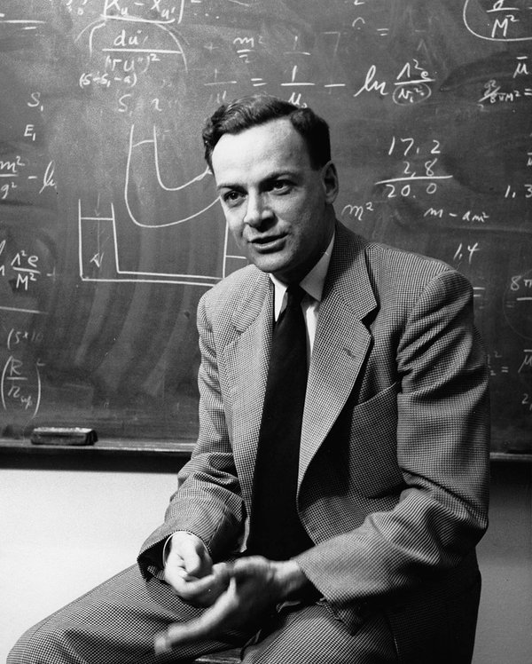
HISTORY
As early as 1959 the American physicist and Nobel laureate Richard Feynman noted that, as electronic components begin to reach microscopic scales, effects predicted by quantum mechanics occur—which, he suggested, might be exploited in the design of more powerful computers.
Figure 3: Caltech physicist and Nobel Laureate Richard Feynman [3]

Slide 12
HISTORY
During the 1980s and ’90s the theory of quantum computers advanced considerably beyond Feynman’s early speculations. In 1985 David Deutsch of the University of Oxford described the construction of quantum logic gates for a universal quantum computer, and in 1994 Peter Shor of AT&T devised an algorithm to factor numbers with a quantum computer that would require as few as six qubits (although many more qubits would be necessary for factoring large numbers in a reasonable time). When a practical quantum computer is built, it will break current encryption schemes based on multiplying two large primes; in compensation, quantum mechanical effects offer a new method of secure communication known as quantum encryption. However, actually building a useful quantum computer has proved difficult.

Slide 13
Future research
Quantum cryptography
While the problem of noise is a serious challenge in the implementation of quantum computers, it isn’t so in quantum cryptography, where people are dealing with single qubits, for single qubits can remain isolated from the environment for significant amount of time. Using quantum cryptography, two users can exchange the very large numbers known as keys, which secure data, without anyone able to break the key exchange system. Such key exchange could help secure communications between satellites and naval ships. But the actual encryption algorithm used after the key is exchanged remains classical, and therefore the encryption is theoretically no stronger than classical methods.

Slide 14
HISTORY
In 1998 Isaac Chuang of the Los Alamos National Laboratory, Neil Gershenfeld of the Massachusetts Institute of Technology (MIT), and Mark Kubinec of the University of California at Berkeley created the first quantum computer (2-qubit) that could be loaded with data and output a solution. Although their system was coherent for only a few nanoseconds and trivial from the perspective of solving meaningful problems, it demonstrated the principles of quantum computation. Rather than trying to isolate a few subatomic particles, they dissolved a large number of chloroform molecules (CHCL₃) in water at room temperature and applied a magnetic field to orient the spins of the carbon and hydrogen nuclei in the chloroform. (Because ordinary carbon has no magnetic spin, their solution used an isotope, carbon-13.) A spin parallel to the external magnetic field could then be interpreted as a 1 and an antiparallel spin as 0, and the hydrogen nuclei and carbon-13 nuclei could be treated collectively as a 2-qubit system..

Slide 15
SUMMARY
Quantum computing is the use of quantum-mechanical phenomena.
Quantum computers, on the other hand, use qubits, which are typically subatomic particles such as electrons or photons.
While the problem of noise is a serious challenge in the implementation of quantum computers, it isn’t so in quantum cryptography, where people are dealing with single qubits, for single qubits can remain isolated from the environment for significant amount of time.

Slide 16
FAQ
1.What leads to origin of Quantum Computing?
2.Define Quantum Computing.
3.What are future applications of Quantum Computing?

Slide 17
REFERENCES
Image References
[1]https://www.theguardian.com/commentisfree/2019/sep/28/google-quantum-computer-internet-security- threat
[2] https://physics.aps.org/articles/v8/87
[3] https://www.caltech.edu/about/news/feynmans-nobel-year-48524
References
https://www.princeton.edu/news/2020/01/21/quantum-computing-opening-new-realms-possibilities
https://www.sciencedaily.com/releases/2020/04/200423130440.htm
https://theconversation.com/a-quantum-computing-future-is-unlikely-due-to-random-hardware-errors-126503

Slide 18
REFERENCES
Video link
https://www.youtube.com/watch?v=F_Riqjdh2oM
https://www.youtube.com/watch?v=OlatlIaqPj8
https://www.youtube.com/watch?v=FnPp73F5cnE
BOOKS
Sahni V., Goswami D. (2008) Nano Computing, McGraw Hill Education Asia Ltd., ISBN: 978007024892Beiser A., Ghatak A, Garg S.C., Applied Physics, Edition 1st, (2013), Tata McGraw-Hill, Noida.

Slide 19
THANK YOU
For queries
Email: arminder.uis@cumail.in

